Slide 1

ALTA Wireless 500 Amp AC Current Meter

Slide 2
Introduction
The ALTA Wireless AC Current Meter measures the RMS current of an alternating current (AC) system using a current transformer (CT) that wraps around the hot wire of a two wire (hot, common, ground(optional)) power system.
The sensor reports Minimum RMS current, maximum RMS current, average RMS current, and amp hours to the iMonnit system.
The iMonnit system is capable of generating watt hour or kilowatt hour readings as well.
Measures amp hours, max RMS current, min RMS current, and average RMS current
Three different current transducers available: Low Current: 0-20 amp, Medium Current: 0-150 amp, High Current: 0-500 amp
Capable of generating watt hour or kilowatt hour readings using iMonnit
Data logging for accumulated amp hour readings
Can notify based on current levels or changes in current levels
Simple and safe installation of current/power measurement hardware, no rewiring required

Slide 3
Principle of Operation
To measure current, clip the CT around only a single wire of the AC system (clipping around a hot and neutral wire at the same time will result in 0 current readings).
After the sensor powers on and connects to the gateway it will begin taking measurements based on the averaging interval (5 seconds default).
It will report data to iMonnit every heartbeat or if the current goes outside of the aware thresholds set in iMonnit.
The sensor reports amp hours, max RMS current, min RMS current, and average RMS current.
iMonnit can also generate watt hour or kilowatt hour readings if a default RMS voltage is set in iMonnit.

Slide 4
Example Applications
Current monitoring
Current usage
Amperage monitoring
Amp hour meter
Factory management
Watt hour meter
Kilowatt hour meter
Breaker panel monitoring

Slide 5
Features
Wireless range of 1,200+ feet through 12+ walls
Frequency-Hopping Spread Spectrum (FHSS)
Improved interference immunity
Improved power management for longer battery life
Encrypt-RF Security (Diffie-Hellman Key Exchange + AES-128 CBC for sensor data messages) - Onboard data memory stores up to 512 readings per sensor: - 10-minute heartbeats = 3.5 days - 2-hour heartbeats = 42 days
Over-the-air updates (future proof)
Free iMonnit basic online wireless sensor monitoring and notification system to configure sensors, view data and set alerts via SMS text and email

Slide 6
Setup and Installation
Step 1:
Add the sensor on iMonnit. Add the sensor to your account by choosing Sensors in the main menu. Navigate to the Add Sensor button.
. Find the device ID. The Device ID (ID) and Security Code (SC) are necessary to add a sensor. These can both be located on the label on the side of your device.
Adding your device. You will need to enter the Device ID and the Security Code from your Sensor in the corresponding text boxes. Use the camera on your smartphone to scan the QR code on your device.
If you do not have a camera on your phone, or the system is not accepting the QR code, you may enter the Device ID and Security Code manually.
The Device ID is a unique number located on each device label. Next, you’ll be asked to enter the Security Code from your device. A security code consists of letters and must be entered in upper case (no numbers). It can also be found on the barcode label of your device.
When completed, select the Add Device button.

Slide 7
Setup and Installation
Step 2: Setup
Select your use case. Choose from the list or create your own custom settings. You will see the heartbeat interval, and aware state settings. Select the Skip button when completed.
Step 3: Validation
Check your signal. The validation checklist will help you ensure your sensor is communicating with the gateway properly and you have a strong signal.
Step 4: Actions
Choose your actions. Actions are the alerts that will be sent to your phone or email in the event of an emergency.
The standard version of this sensor is powered by two replaceable 1.5 V AA sized batteries (included with purchase). The typical battery life is up to 10 years.

Slide 8
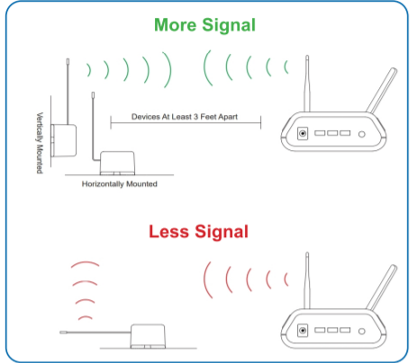
Antenna orientation
In order to get the best performance out of your ALTA Wireless Sensors, it is important to note proper antenna orientation and sensor positioning. Antennas should all be oriented in the same direction, pointing vertically from the sensor.
If the sensor is mounted flat on its back on a horizontal surface, you should bend the antenna as close to the sensor housing as possible giving you the most amount of antenna pointing vertical.
You should make the antenna wire as straight as possible, avoiding any kinks and curving of the wire. Sensors must be at least 3 ft. away from other sensors and the wireless gateway to function.

Slide 9

Sensor Overview In iMONNIT
Select Sensors from the main navigation menu on iMonnit to access the sensor overview page and begin making adjustments to your Advanced Vibration Meter.
A. Details - Displays a graph of recent sensor data.
B. History - List of all past heartbeats and readings.
C. Events - List of all events attached to this sensor.
D. Settings - Editable levels for your sensor.
E. Scale - Set the scale your sensor will take readings at
Directly under the tab bar is an overview of your sensor. This allows you to see the signal strength and the battery level of the selected sensor. A coloured dot in the left corner of the sensor icon denotes its status.
Green indicates the sensor is checking in and within user-defined safe parameters.
Red indicates the sensor has met or exceeded a user-defined threshold or triggered event.
Grey indicates that no sensor readings are being recorded, rendering the sensor inactive.
Yellow indicates that the sensor reading is out of date, due to perhaps a missed heartbeat check-in.

